Slide 1
A data driven Exploration of Apple’s iPhone impact in India
By:
Abikail
Birunda
Dharshini
Devadharshini

Slide 2
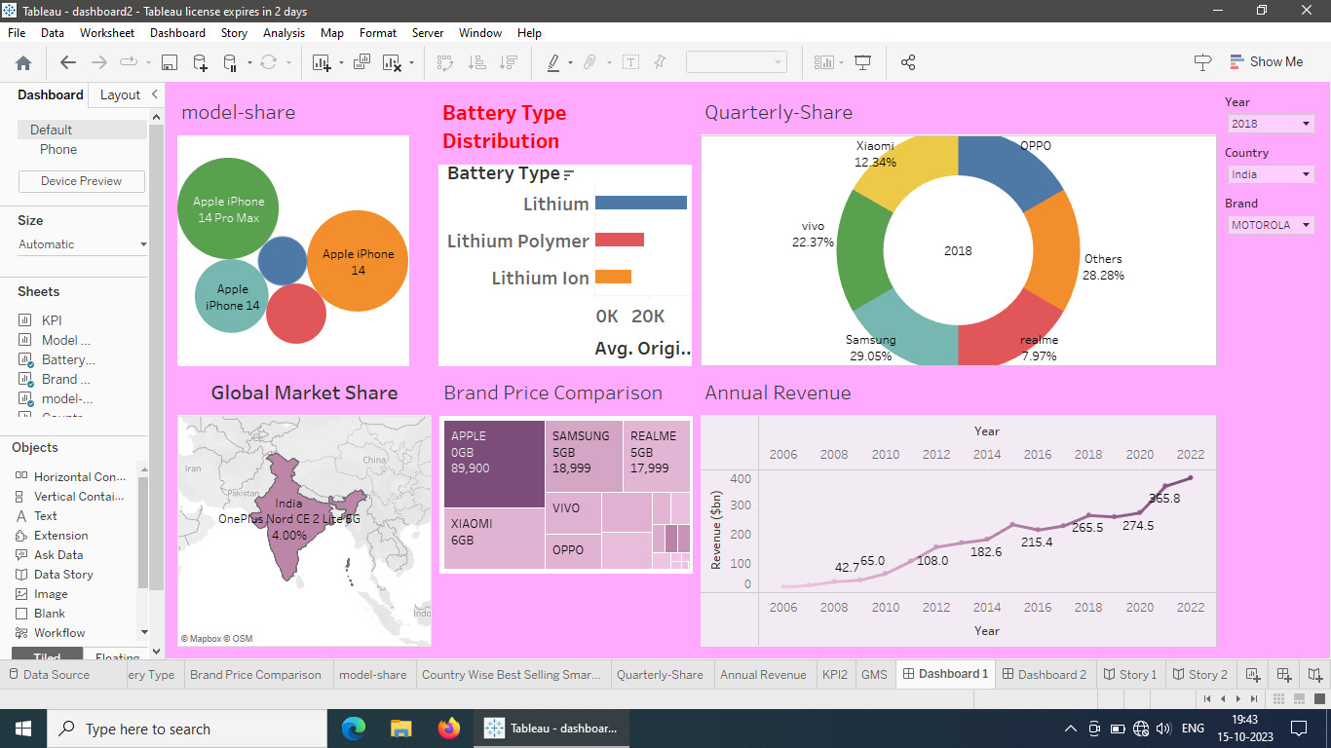

Slide 3
